Slide 1
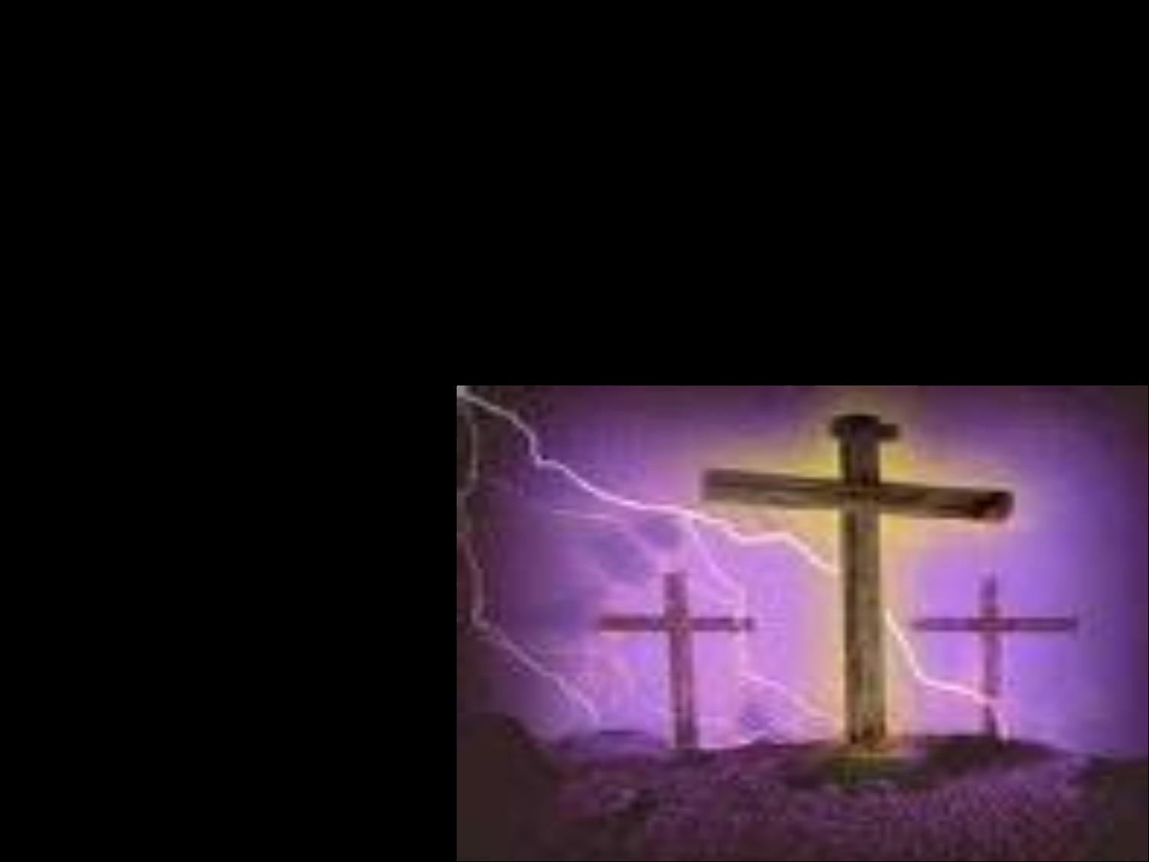
我深信在那各各他山顶
I Believe in a hill Called Mount Calvary

Slide 2
人一生在世如客旅转眼逝去，
世上并无一处能久留；
虽然有名利财宝一生在追求，
但不能使我永远拥有。
There are things as we travel this earth’s shifting sands
That transcend all the reason of man;
But the things that matter the most
in this world,
They can never be held in our hand.

Slide 3
我深信在那各各他山顶
我救主曾为我被挂；
当岁月渐渐消失，世界成过去，
我仍愿倚靠古旧十架。
I believe in a hill called Mount Calvary
I’ ll believe whatever the cost;
And when time has surrendered and
earth is no more,
I’ll still cling to that old rugged cross.

Slide 4
我深信基督既为人受死十架，
今日能使你生命改变；因为祂曾改变我。赐我新生命，
我今愿靠近十架身边。
I believe that the Christ who was slain on that cross
Has the power to change lives today;
For He changed me completely,
a new life is mine,
That is why by the cross I will stay.

Slide 5
我深信在那各各他山顶
我救主曾为我被挂；
当岁月渐渐消失，世界成过去，
我仍愿倚靠古旧十架。
I believe in a hill called Mount Calvary
I’ ll believe whatever the cost;
And when time has surrendered and
earth is no more,
I’ll still cling to that old rugged cross.

Slide 6
我深信人生雖然如謎難測透， 有一天這一切將結束；
但因信我能得勝 死亡與黑暗， 到天家與我良友同住。
I believe that this life with its great mysteries Surely someday will come to an end; But faith will conquer the darkness and death And will lead me at last to my Friend.

Slide 7
我深信在那各各他山顶
我救主曾为我被挂；
当岁月渐渐消失，世界成过去，
我仍愿倚靠古旧十架。
I believe in a hill called Mount Calvary
I’ ll believe whatever the cost;
And when time has surrendered and
earth is no more,
I’ll still cling to that old rugged cross.

Slide 8
当岁月渐渐消失，世界成过去，
我仍愿倚靠古旧十架。
And when time has surrendered and
earth is no more,
I’ll still cling to that old rugged cross.

